Slide 1
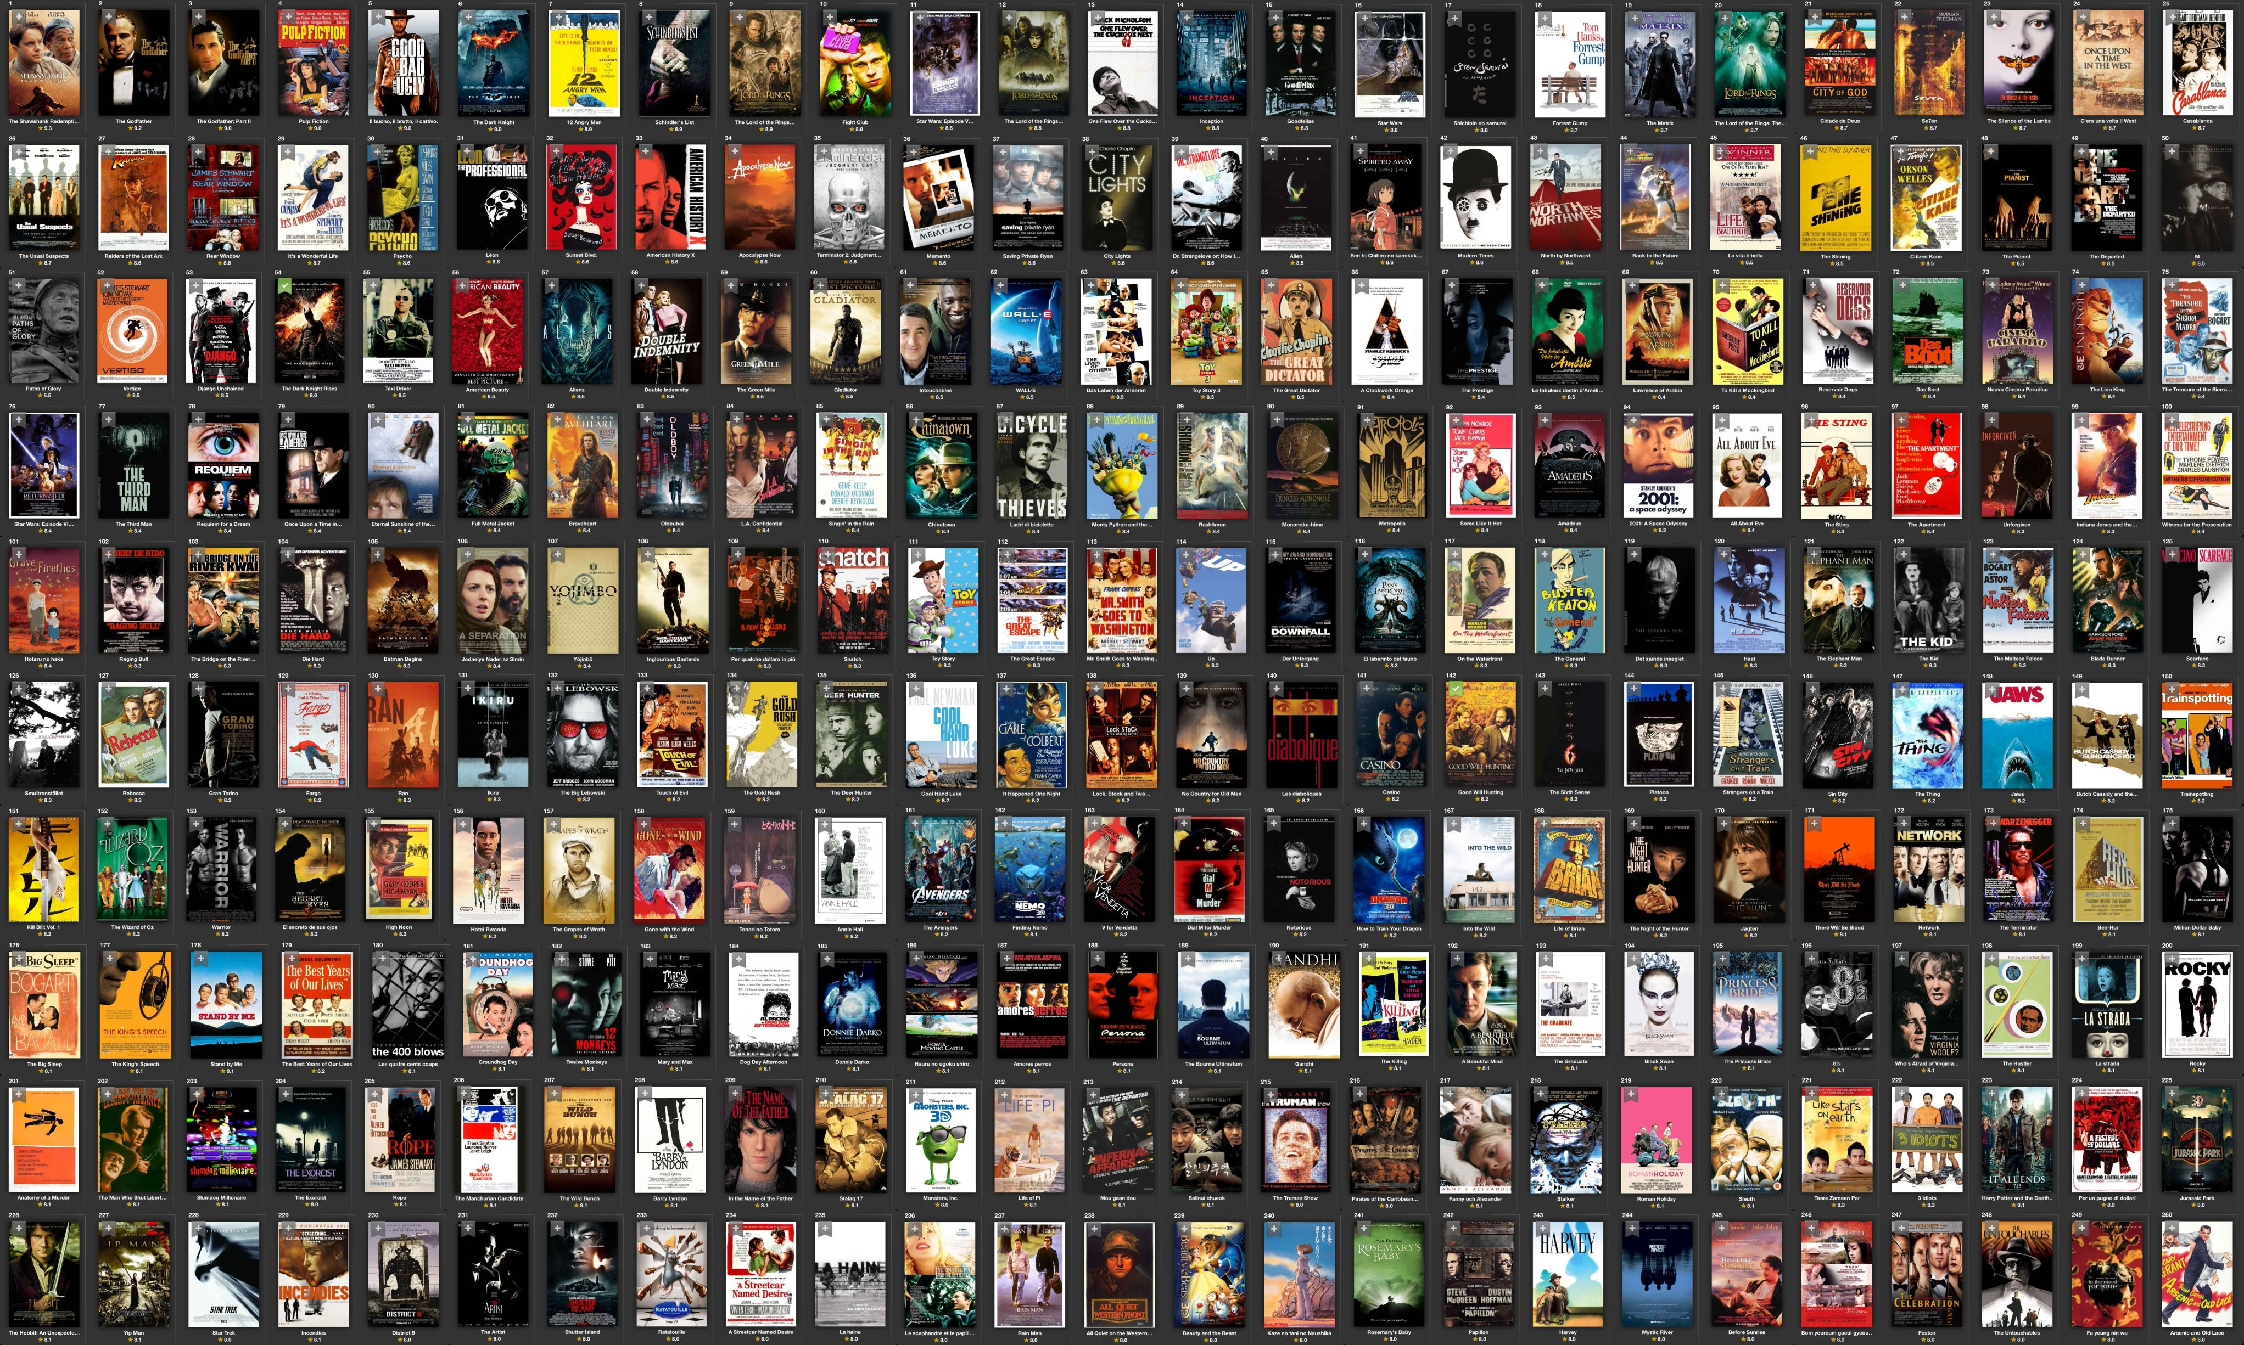
Testing a website
By Team 4

Slide 2


A little pre-Christmas promotion, in case you feel like cooking...

Slide 3

But this advert was really just an introduction to the team's approach to the project this week:

Slide 4


Slide 5

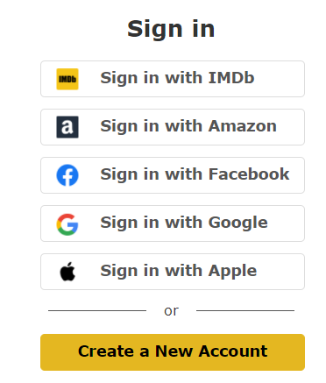
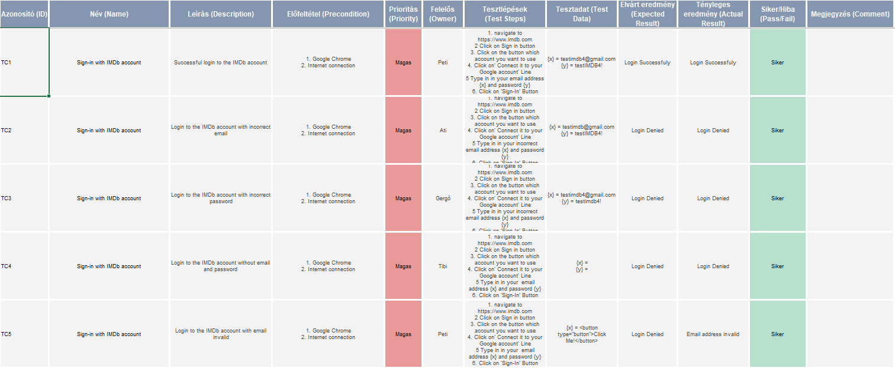
1. Successful login to the IMDb account with
We had to log in to IMDB first, but we didn't find any problems...

Slide 6
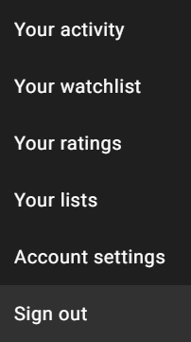
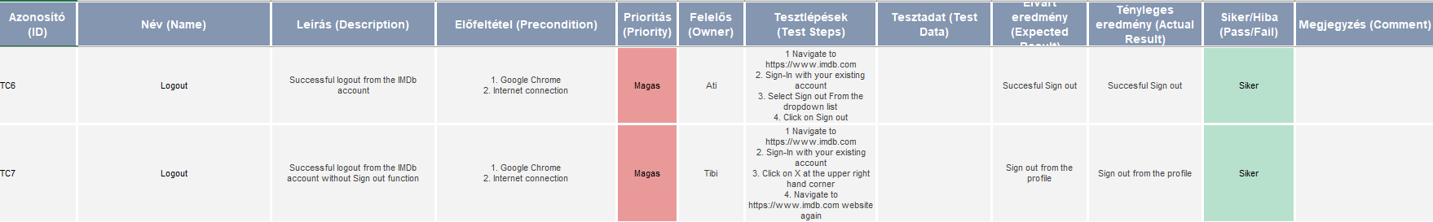
2. Successful logout from the IMDb account
And at check-out we couldn't find...
But we never gave up hope, because...

Slide 7
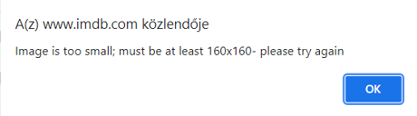
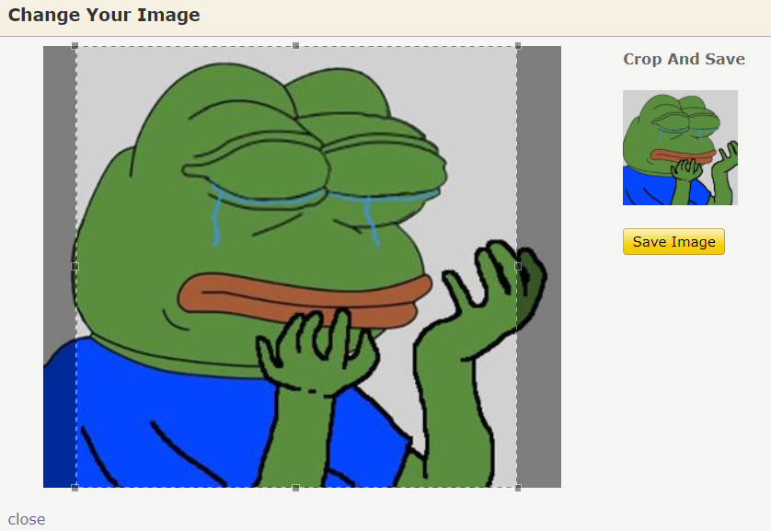
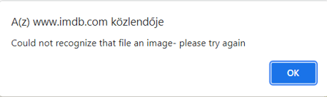
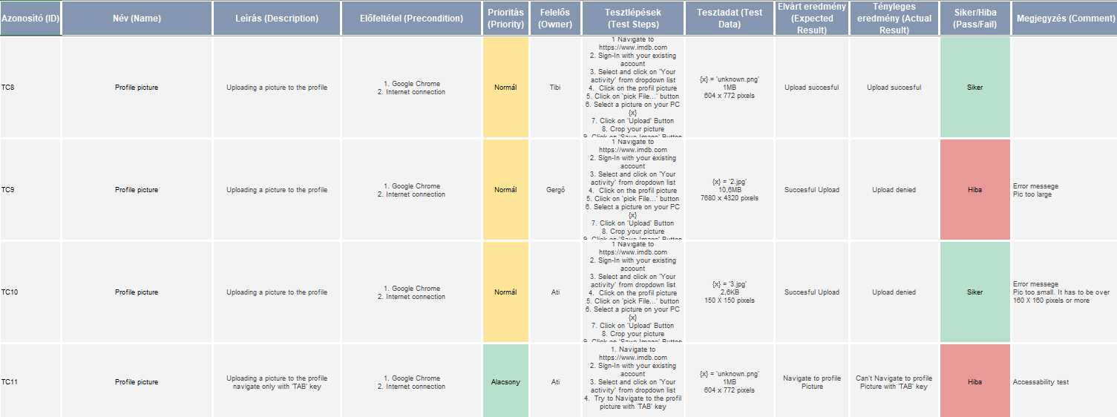
3. Uploading a picture to the profile
We found two in the profile picture upload!

Slide 8
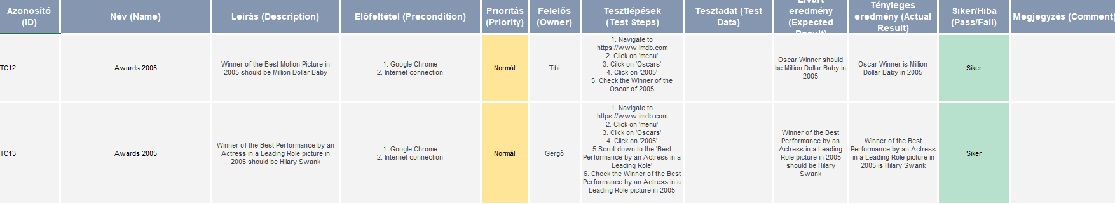
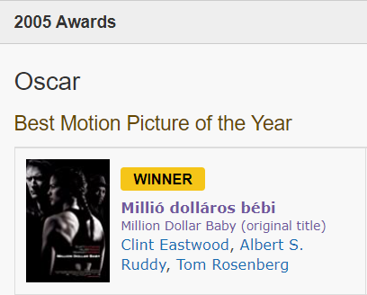
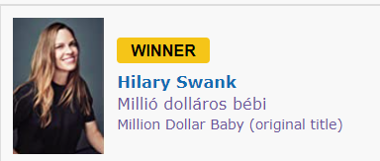
4. Validating some of the Oscar winners in 2005
We couldn't argue with that.

Slide 9
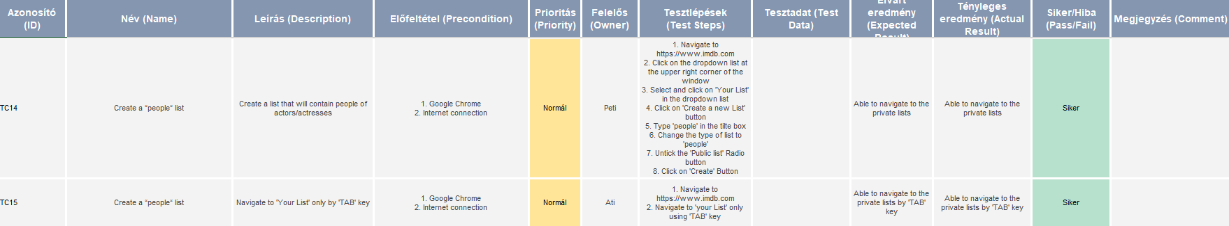
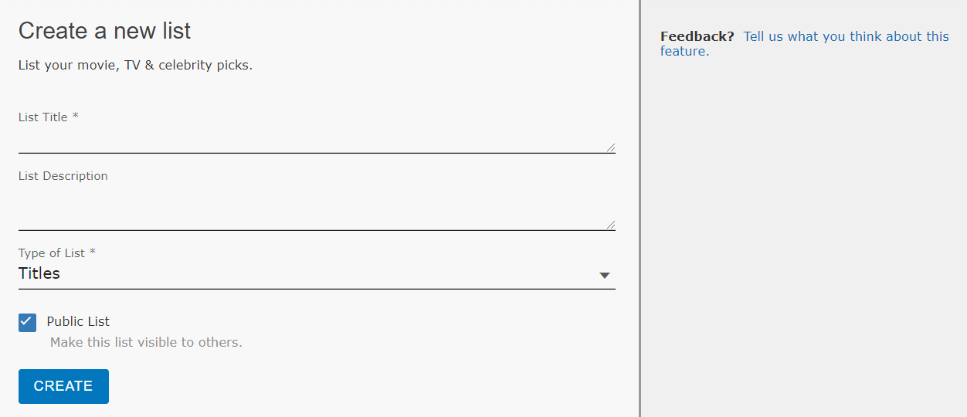
5. Create a list that will contain people
We have also made a list.

Slide 10
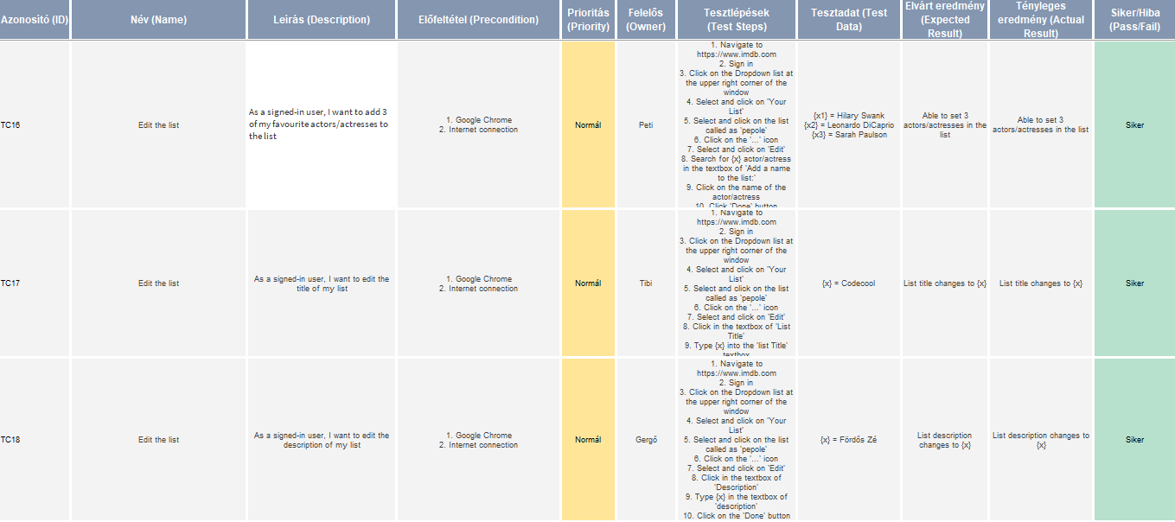
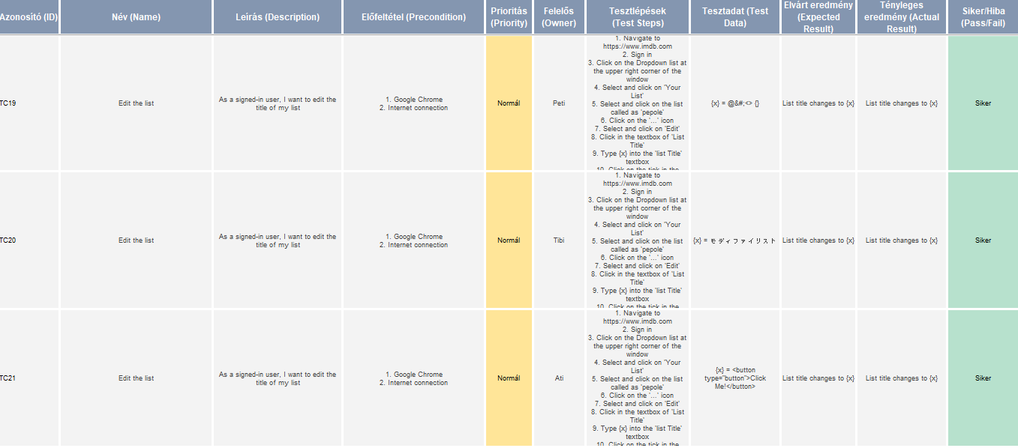
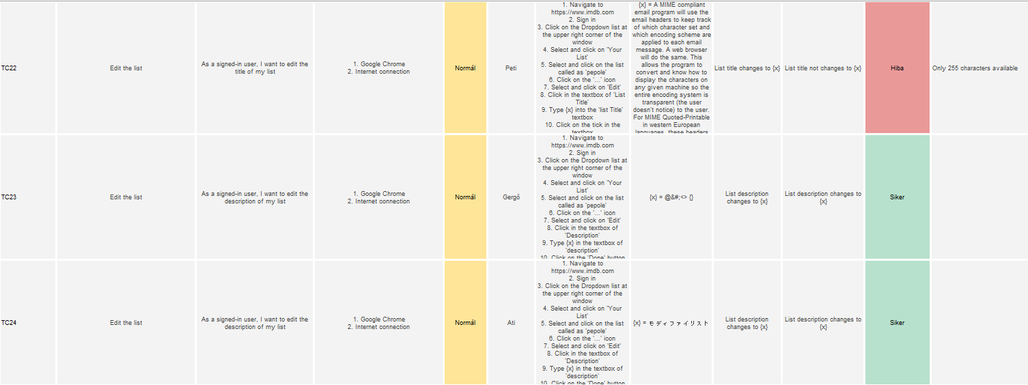
6. Edit the list
We tried here too.

Slide 11
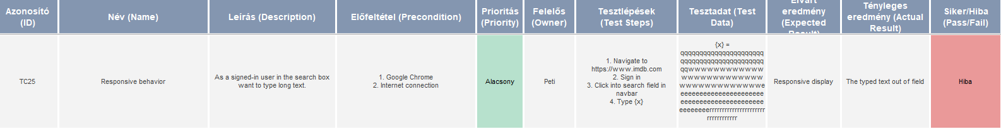
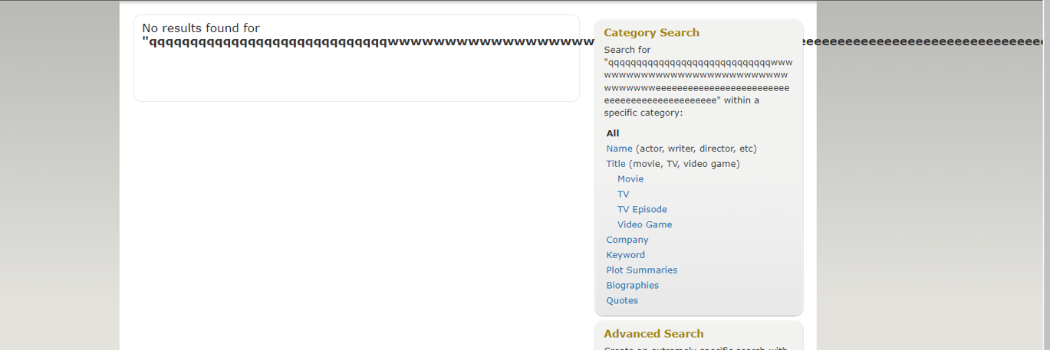
+1. Search box
And we just found this by chance.
It looks baaaaaaaaaaaaaaaaaaaaaaaaaaaaaaaaaaaaaaaaaaaaaaddddddddddddddd.

Slide 12
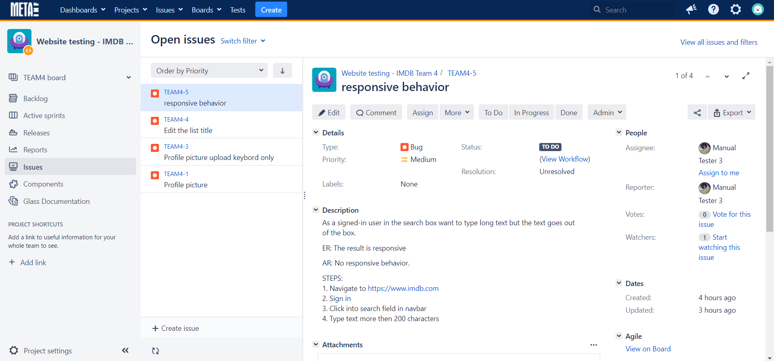
Now let's look at the tasks!
And Jira.
Just to make everything good.

Slide 13

Thank You!

